Slide 1

Severity Classification of Accidents involving Powered Two Wheelers
By
Vijay Kumar Reddy Almalachervu
Prathyusha Anireddy
Divya Gummadi
Yugender Kolluru

Slide 2

Area of Research
Introduction
Motivation
Applications
Issues and Challenges
Objectives
Proposed System
Implementation
Result
Demo

Slide 3
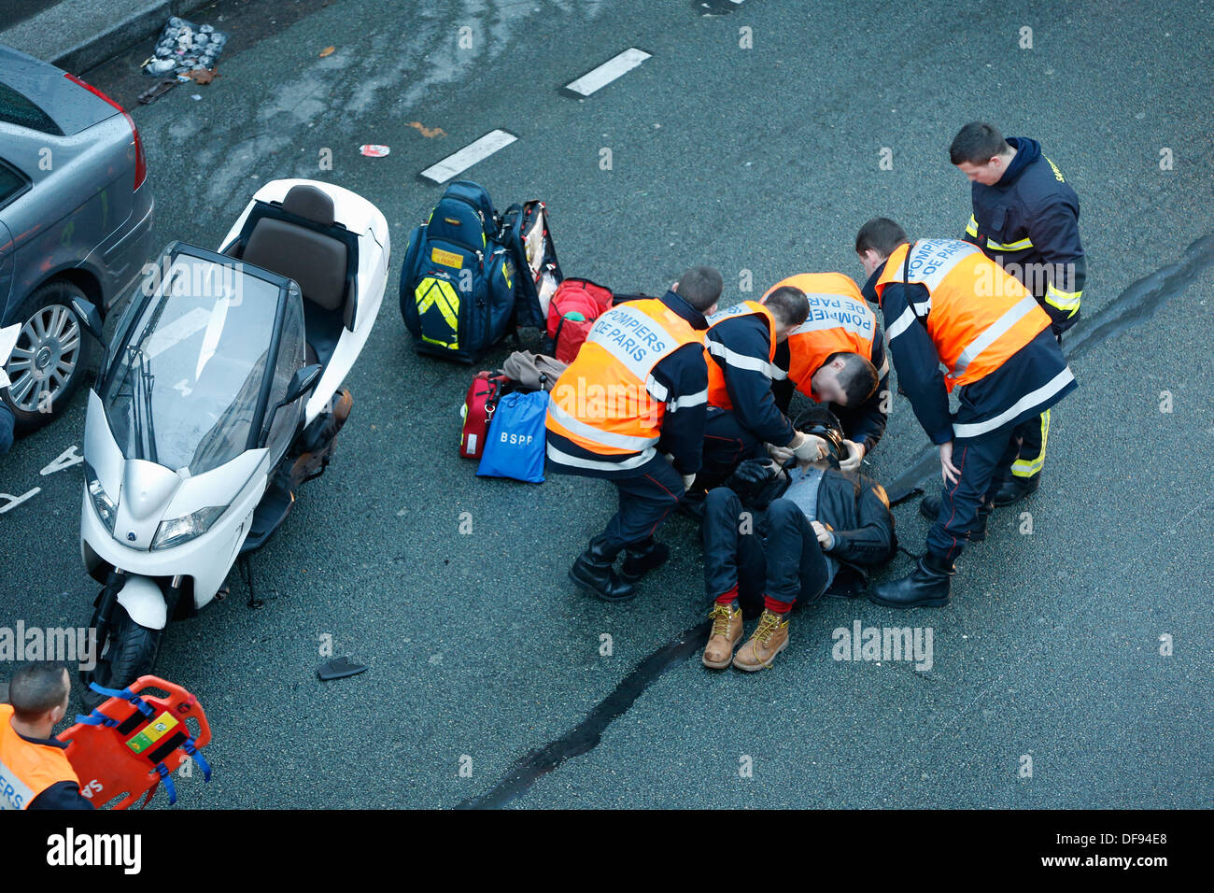
Area of Research
Accident Analysis and Prediction

Slide 4
Introduction
Road traffic injuries and deaths have been a major public health issue globally. According to world Health Organization, approximately 1.35 millions people die from roadway traffic accidents each year, while 20-50 million people suffer nonfatal injuries with many resulting in disabilities
Road accidents in India claimed over 1.5 lakh lives in the country in 2016, with over speeding of vehicles being the biggest reason for casualties
The ministry of road transport and highways issued a report on Road Accidents in India in 2018 which showed that accident last year increased by 0.46 as compared.

Slide 5
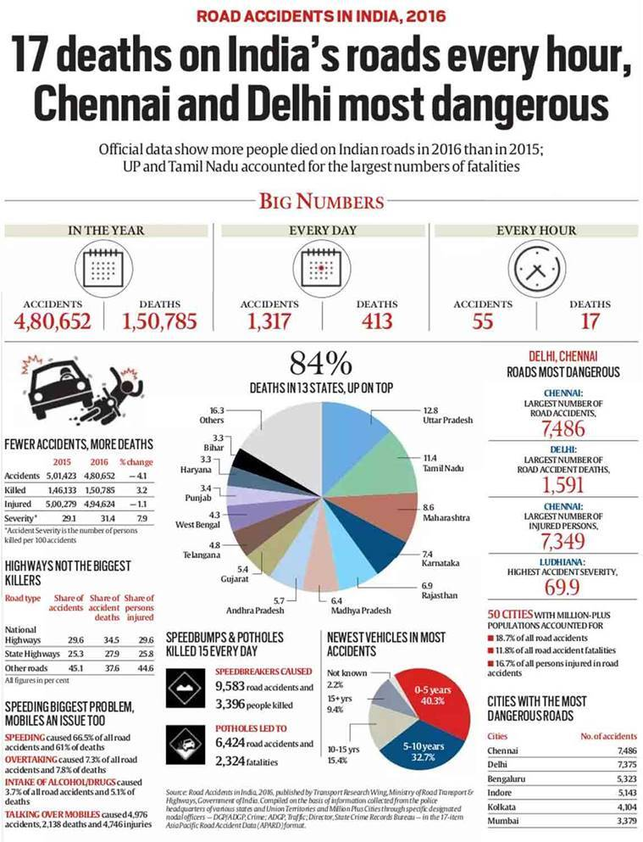
Cont’d
Accidents involving Powered Two Wheelers

Slide 6

Motivation
Increased highway accident and rise in death toll everyday.
Over speeding accounted for 64.4% of the persons killed.

Slide 7
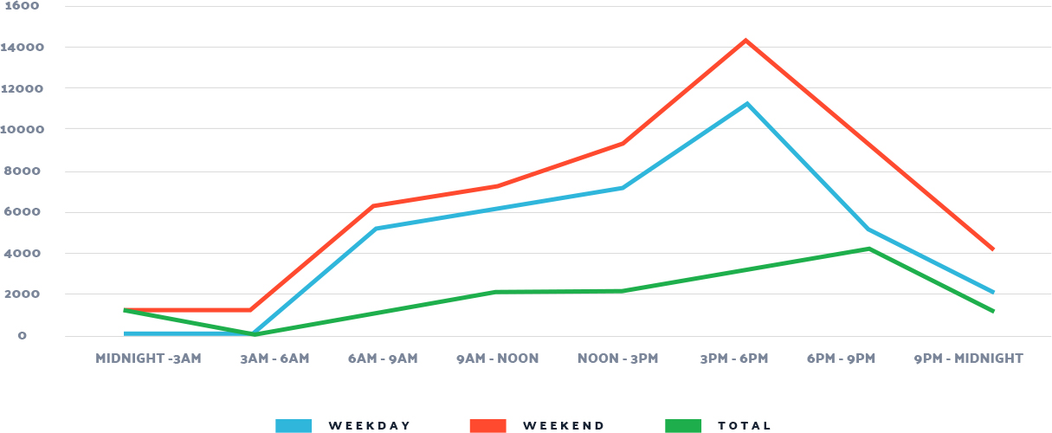

Slide 8

Applications
Help in designing road geometry.
Help in finding those spot-on road where chance of accident is high.
Help in installing the road surveillance.
Road network simulation
Help in study of Road Intersection

Slide 9
Issues and Challenges
Proper selection of features which can cause a road accident.
Removal of unwanted features.
Collection data should be valid and related to real life accident situations.
Removal of outlier instances.

Slide 10
Objectives
To evaluate factors contributing to road accidents.
To review related systems and models for predicting the likelihood of causing an accident.
To develop an algorithm for predicting the likelihood of causing an accident.
To test and validate the developed algorithm.

Slide 11
Cont’d
Human
Factors
Road Accidents Causes
Road Design
Sociological Factors
Others

Slide 12

Proposed System
Preprocessing
Data cleaning
Data Integration
Data Reduction
Data Transformation
Classification
Logistic Regression
Support Vector Machine
Random Forest
Deep Neural Network
Evaluation
Accuracy

Slide 13
Implementation
We employed four different data mining approaches in this study.
Logistic Regression
Random Forests
Support Vector Machines
Deep Neural Networks

Slide 14
Logistic Regression
In regression analysis, logistic regression (or logit regression) is estimating the parameters of a logistic model (a form of binary regression). Mathematically, a binary logistic model has a dependent variable with two possible values, such as pass/fail which is represented by an indicator variable, where the two values are labeled "0" and "1".
Logistic regression uses an equation as the representation, very much like linear regression. Input values (x) are combined linearly using weights or coefficient values (referred to as the Greek capital letter Beta) to predict an output value (y).

Slide 15
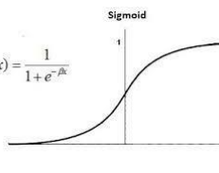
A key difference from linear regression is that the output value being modeled is a binary values (0 or 1) rather than a numeric value. Below is an example logistic regression equation: y = e^(b0 + b1*x) / (1 + e^(b0 + b1*x))

Slide 16
Advantages | Disadvantages
Logistic regression is easier to implement, interpret, and very efficient to train. | It is tough to obtain complex relationships using logistic regression. More powerful and compact algorithms such as Neural Networks can easily outperform this algorithm
It can easily extend to multiple classes (multinomial regression) and a natural probabilistic view of class predictions. | Non-linear problems can’t be solved with logistic regression because it has a linear decision surface. Linearly separable data is rarely found in real-world scenarios.
It is very fast at classifying unknown records. | The major limitation of Logistic Regression is the assumption of linearity between the dependent variable and the independent variables.
It can interpret model coefficients as indicators of feature importance. | If the number of observations is lesser than the number of features, Logistic Regression should not be used, otherwise, it may lead to overfitting.

Slide 17
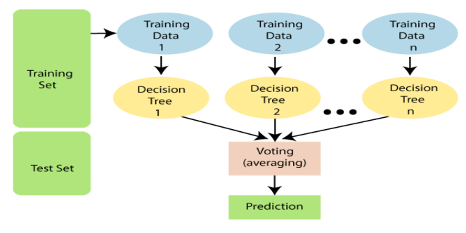
Random Forests
Random forests are a scheme is for building a predictor ensemble with a set of decision trees that grow in randomly selected subspaces of data. Despite growing interest and practical use, there has been little exploration of the statistical properties of random forests, and little is known about the mathematical forces driving the algorithm.
The Random Forest algorithm builds multiple Decision Trees and grows them to the largest extent possible. Each decision tree is created by selecting a sample of n examples at random, with replacement, where n is the size of the training set. At each node in the tree, only a subset k of all K features is tested 39 for attribute selection.

Slide 18
Advantages | Disadvantages
Random Forest algorithm is less prone to overfitting than Decision Tree and other algorithms. The outputs the importance of features which is a very useful | Random Forest creates a lot of trees (unlike only one tree in case of decision tree) and combines their outputs. By default, it creates 100 trees in Python sklearn library. To do so, this algorithm requires much more computational power and resources. On the other hand decision tree is simple and does not require so much computational resources.
Random Forest can be used to solve both classification as well as regression problems. It works well with both categorical and continuous variables. | Random Forest require much more time to train as compared to decision trees as it generates a lot of trees (instead of one tree in case of decision tree) and makes decision on the majority of votes
Random Forest can automatically handle missing values. It is usually robust to outliers and can handle them automatically.

Slide 19
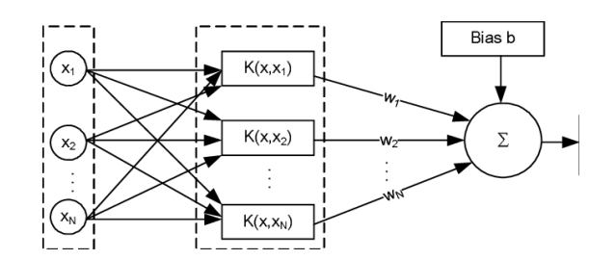
Support Vector Machines
The key idea of the algorithm is to identify the maximum margin hyperplane as the decision surface for a particular type of classification task.
The kernel function can be a linear or non-linear function, allowing to capture the dependencies between the input variables and the target. If the kernel function is simply a dot product (as the sum of products of the corresponding vector elements), then the resulting decision function is a linear.

Slide 20
Advantages | Disadvantages
SVM has L2 Regularization feature. So, it has good generalization capabilities which prevent it from over-fitting. | Choosing an appropriate Kernel function is not an easy task. It could be tricky and complex. In case of using a high dimension Kernel, you might generate too many support vectors which reduce the training speed drastically.
SVM can be used to solve both classification and regression problems. SVM is used for classification problems while used for regression problems. | Algorithmic complexity and memory requirements of SVM are very high. You need a lot of memory since you must store all the support vectors in the memory and this number grows abruptly with the training dataset size.
SVM can efficiently handle non-linear data using Kernel trick. | One must do feature scaling of variables before applying SVM.
A small change to the data does not greatly affect the hyperplane and hence the SVM. So the SVM model is stable. | SVM takes a long training time on large datasets. SVM model is difficult to understand and interpret by human beings unlike Decision Trees

Slide 21
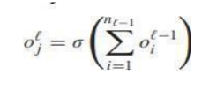
Deep Neural Networks
In the last decade, deep learning has revolutionized the fields of machine learning and artificial intelligence. In this work, we consider the simplest architecture, namely multilayer feed-forward neural networks. Such a network can be defined as a stack of L layers, each consisting of nl neurons.
Creative and analytical components of information are analyzed and grouped to ensure that the object is identified correctly. These components are not brought to the system directly, thus the ML system has to modify and derive them. 43 In a feed-forward neural network, the output of neuron j in layer l is a non-linear function of the output of all the neurons in layer l − 1:

Slide 22
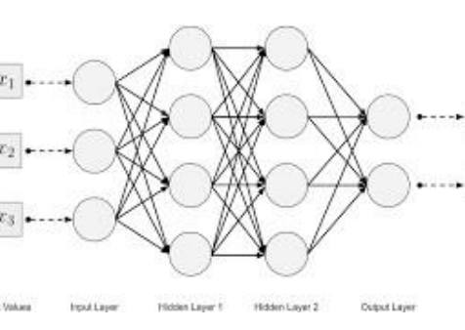
Cont’d
the standard activation function in deep networks has become the Rectified Linear Unit (ReLU) [42]: σ (x) = max(0, x), which overcomes the problem of vanishing gradients, allowing networks to be trained with standard backpropagation.
Deep neural network models are heavily resource-intensive, all the more when ensembles of multiple models are involved. Each retinal image may take seconds to analyze, including preprocessing steps, even with GPUs available. Remote hosting of models may also be infeasible in less-developed environments.

Slide 23
Advantages | Disadvantages
Features are automatically deduced and optimally tuned for desired outcome. Features are not required to be extracted ahead of time. This avoids time consuming machine learning techniques. | There is no standard theory to guide you in selecting right deep learning tools as it requires knowledge of topology, training method and other parameters. As a result, it is difficult to be adopted by less skilled people.
Robustness to natural variations in the data is automatically learned. | It requires very large amount of data in order to perform better than other techniques
The same neural network-based approach can be applied to many different applications and data types. | It is extremely expensive to train due to complex data models. Moreover, deep learning requires expensive GPUs and hundreds of machines. This increases cost to the users
Massive parallel computations can be performed using GPUs and are scalable for large volumes of data. Moreover, it delivers better performance results when amount of data are huge | It is not easy to comprehend output based on mere learning and requires classifiers to do so. Convolutional neural network-based algorithms perform such tasks

Slide 24
Data Set
As already mentioned above, two different datasets are constructed. Dataset A consists of 16,463 instances described by 25 variables, with no missing values, without any information about the speed of the vehicle.
In Dataset A, a total of 7,736 eCall relevant cases are present (positive class), while the remaining 8,727 examples are reported as not relevant (negative class).
In Dataset B variable trav_sp is instead included, heading to a total of 7,424 examples (3,346 eCall relevant and 4,078 not relevant). Table I shows the number of observations for each of the two classes and in each considered dataset. We will also produce two additional versions of the datasets, named C and D, including only a subset of features identified through some feature selection methods.

Slide 25
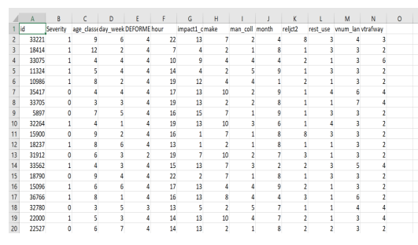
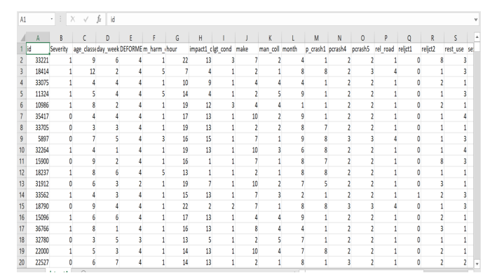
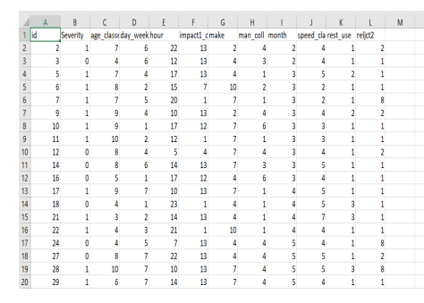
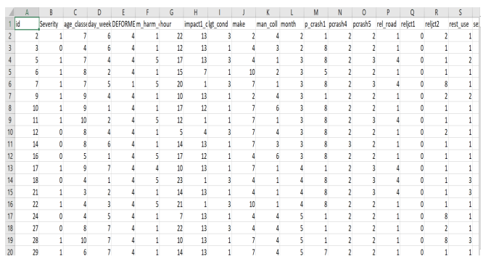
Cont’d
Here are the photos for our project's data sets.

Slide 26
Result
To compare the performance of the systems, we used the same 20-fold cross- validation split for all of them, exploiting hyperparameter tuning on the first fold. For random forests, we used 1,000 estimators (i.e., trees) and the default values for all the other hyper-parameters. For support vector machines, we tested both linear and radial basis function (rbf) kernel, with a grid search over the values of C (linear) and (C,γ) pairs (rbf). For deep networks, we used the hyperas package for hyper-parameter optimization in order to efficiently select the best network architecture.
Results obtained by the compared machine learning classifier the task of ptw severity accident classification. Dataset A, without speed information .
dataset b,including speed information.

Slide 27
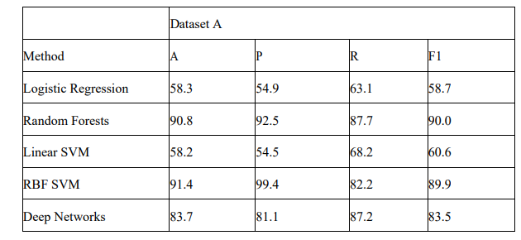

Slide 28
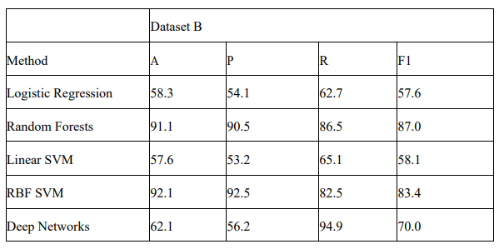

Slide 29
Demo
The link for demo is added to the comments

Slide 30


